Slide 1




Data Science Project
World of
the Rich
Group 12
Pranav Kumar ANupam
Amitesh Singh
Vikram Kumar
Niranjan Dey
Instructor: Dr. Dootika Vats

Slide 2

Why this Project?
About the Data
Challenges Faced
Interesting Questions
Shiny R App
Conclusion
References
Presentation Main Points

Slide 3






Why did we choose this project?
There is much curiosity about the rich, where they come from, who are they and how they come to be. We try to answer such questi0ns about top billionaires of the world.
Here we can see why…

Slide 4





About the data

Slide 5

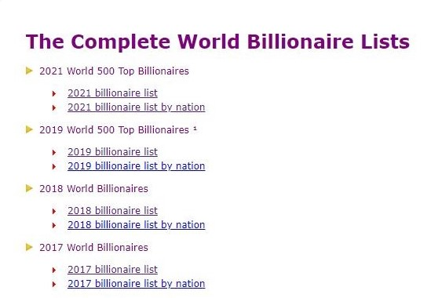

Source of the Data:
Which provides data in a simple format
This link provides data of top 500 Billionaires of past 10 years:
https://stats.areppim.com/stats/links_billionairexlists.htm

Slide 6
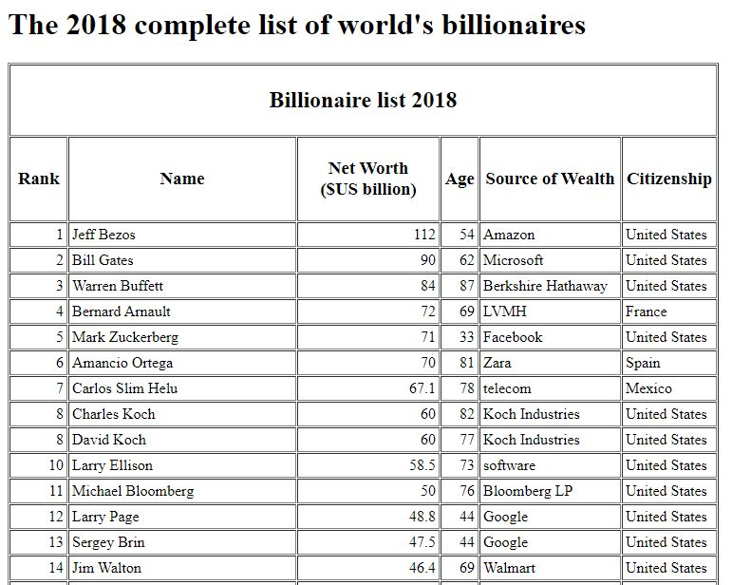
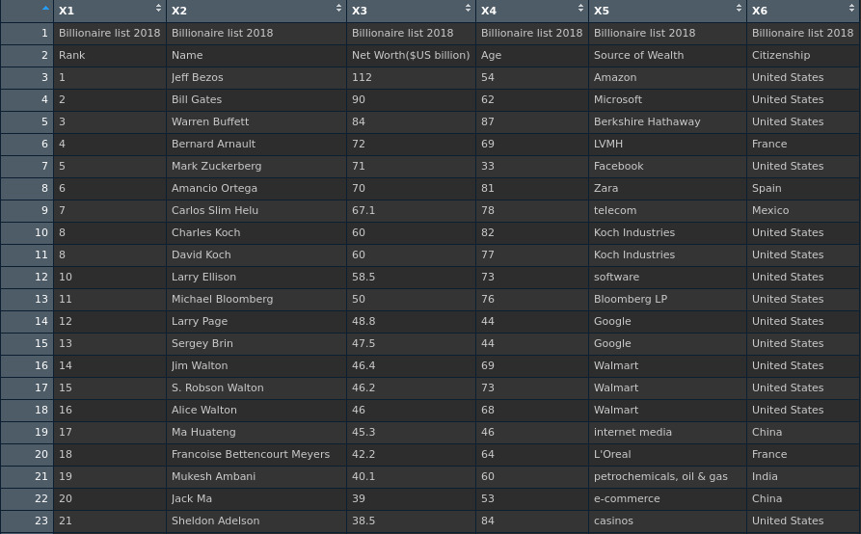
Extracting the Data:
Using R libraries
rvest and tidyverse
Used html_table to extract tables
Cleaned and formatted the data using dplyr

Slide 7

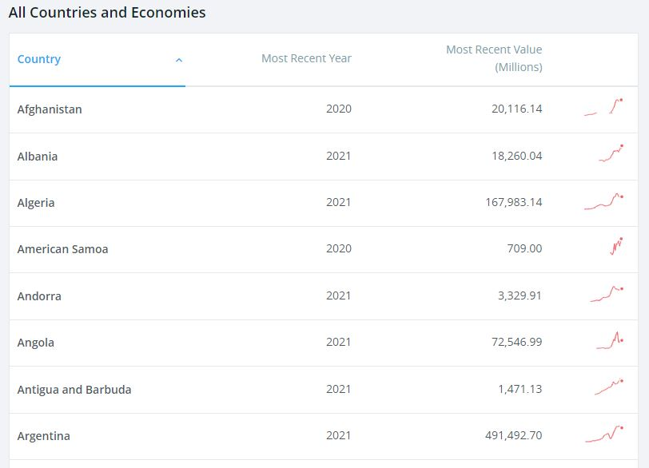
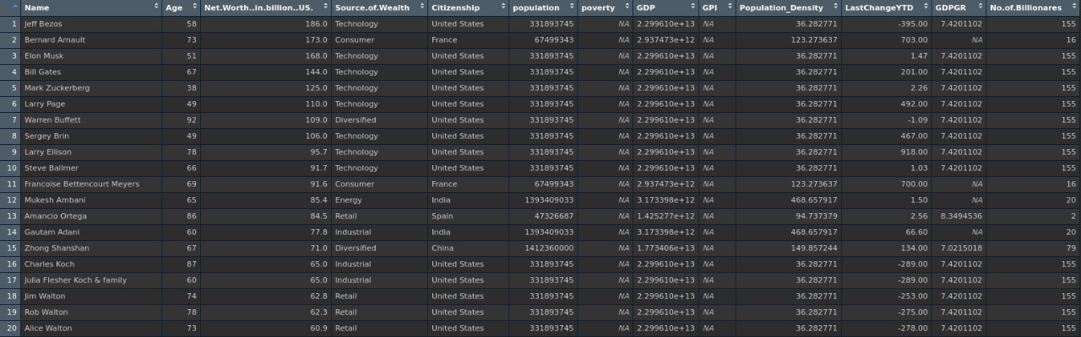
To study the Relation between Billionaire’s & Country’s Wealth
We have extracted recent data about the Country’s wealth of the year 2021 to complement our data.
Source:
https://data.worldbank.org/indicator/NY.GDP.MKTP.KD.ZG
https://data.worldbank.org/indicator/NY.GDP.MKTP.CD

Slide 8


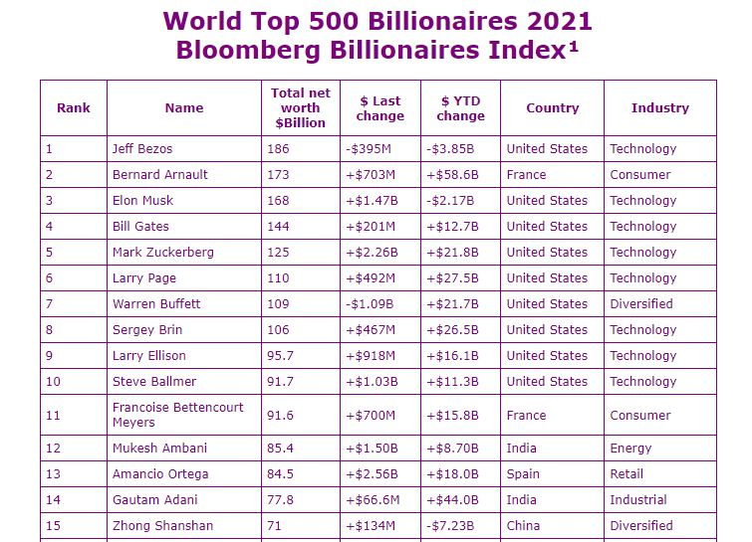
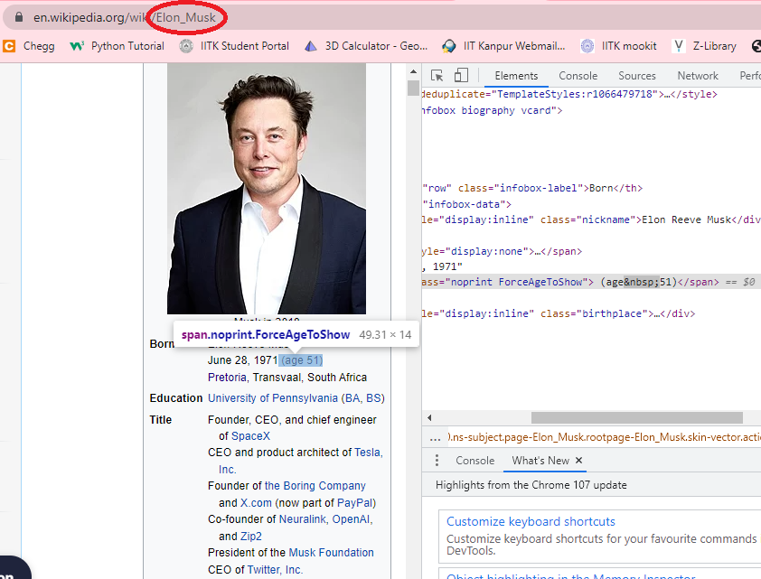
Challenges faced:
Solution:
Ages were not there in 2021 and 2019 tables.
We extracted ages using the “Names” of the billionaires from Wikipedia.

Slide 9
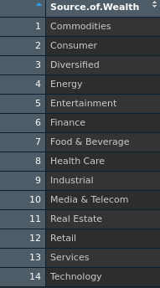
Challenges faced:
Solution:
Source of wealth was not categorized in 2011-2018 data.
We mapped those unique categories to the following 14 categories.

Slide 10
Challenges faced:
Solution:
There were missing values in the tables we scraped. Those were represented by different characters in different tables like “N/A”, “n/a”, “-” etc.
The heading names were not uniform across the tables of various years.
We were required to transform the data frames to get summary, create the various plots.
We transformed all the non integer values to NA values.
We used select function in dplyr to transform column names.
We had transformed the data frames a lot using dplyr.

Slide 11
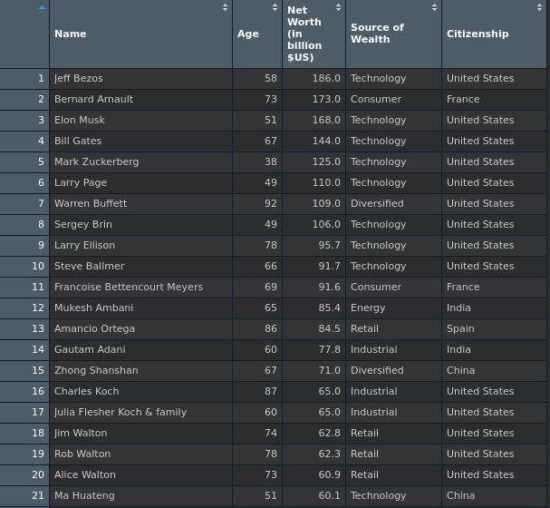
Final Data:
The data consists of a list of 10 data frames of the years 2011-2021 except 2020 (not available due to Covid). Each data frame has 5 columns and 500 rows.
The column headings are:
Name
Age
Net worth (in billion $US)
Source of wealth
Citizenship

Slide 12
Interesting Questions
&
Related Plots

Slide 13

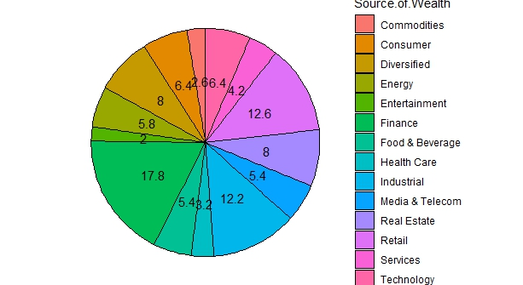

Which industry to choose to become a Billionaire?
Finance and Retail were the wealthiest industries until Technology overtook them in the recent years.

Slide 14
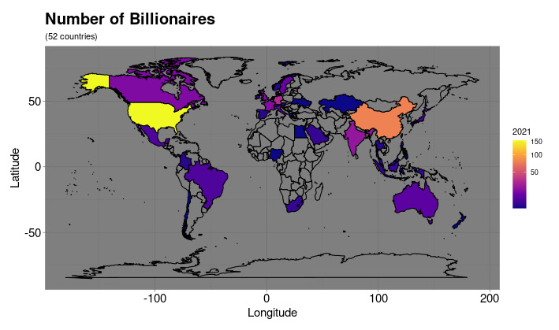
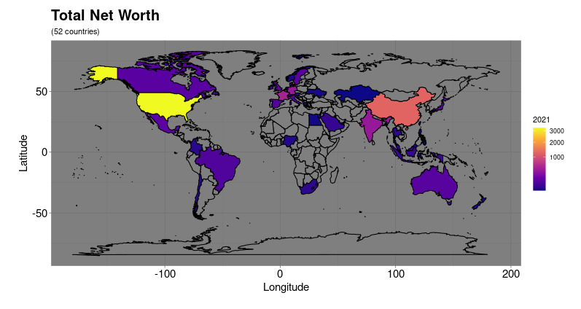
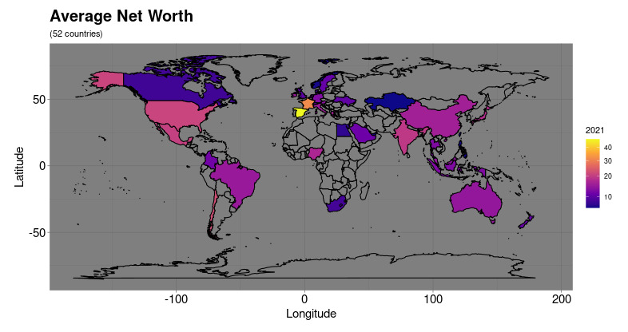
Which place produces the most Billionaires?
China has high Number of billionaires but average Net worth is low.
In some of the European countries, there are less number of billionaires but they own more than average.
Africa turns out to have least number of billionaires.

Slide 15
Top 10 Billionaires Race:
Generally, everyone’s net worth has grown in the past 10 years.
Some like Elon Musk and Jeff Bezos jumped to the top positions in recent time.

Slide 16
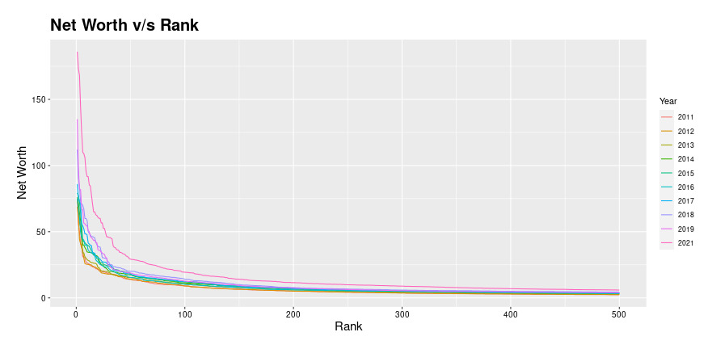
Distribution of Net worth among top 500 Billionaires:
The net worth decreases exponentially as we go to the higher rank.
The top 20-25 ranks have much more net worth than the rest.

Slide 17
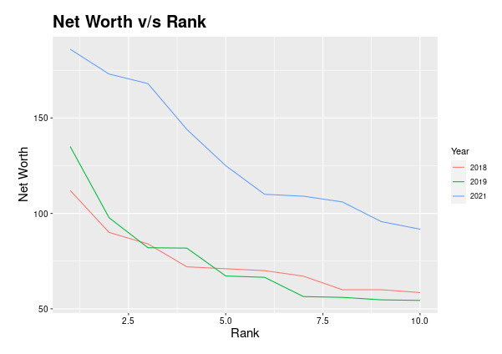

Wealth of worlds 10 richest Doubled in Pandemic
This plot clearly indicates 1.5 to 2 times increase in the wealth of top 10 Billionaires.

Slide 18
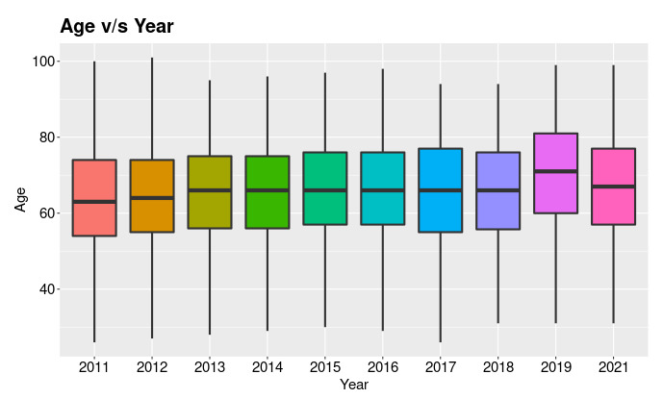
Distribution of age of the Billionaires:
The ages of the top 500 billionaires has roughly remain the same for last 10 years.
Most of them belong to 40-80 age group.

Slide 19
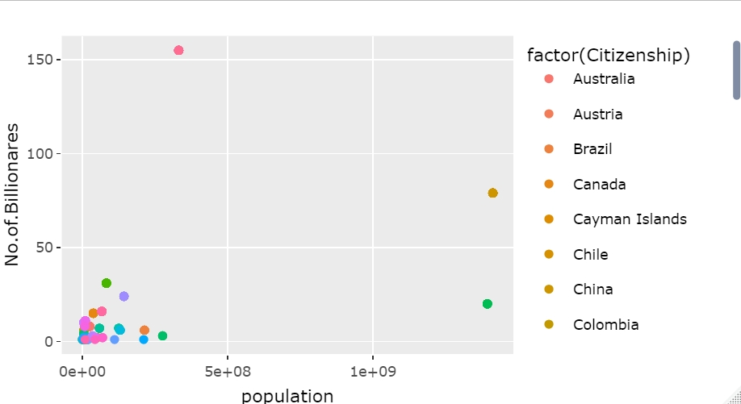
Relation between Number of Billionaires and Population
There is no significant relation between Number of Billionaires and Population.

Slide 20
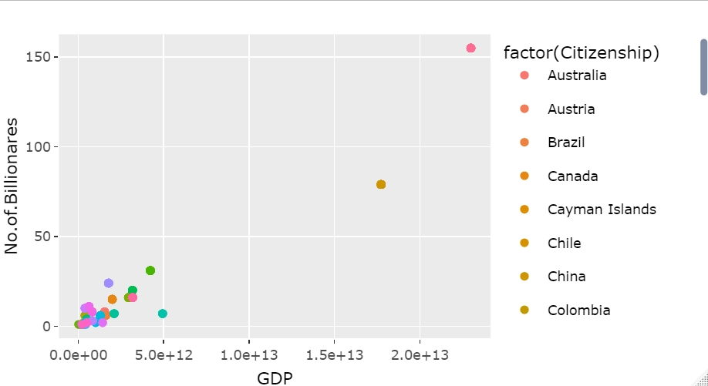
Relation between Number of Billionaires and GDP
There is a positive relation between Number of Billionaires and GDP.

Slide 21
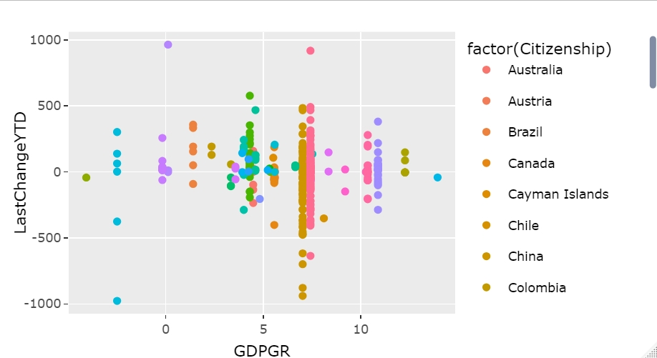
Relation between Billionaires Last change YTD and GDP Growth Rate
There seems to be no relation between Billionaires last change YTD and GDPGR.

Slide 22
Shiny R App

Slide 23
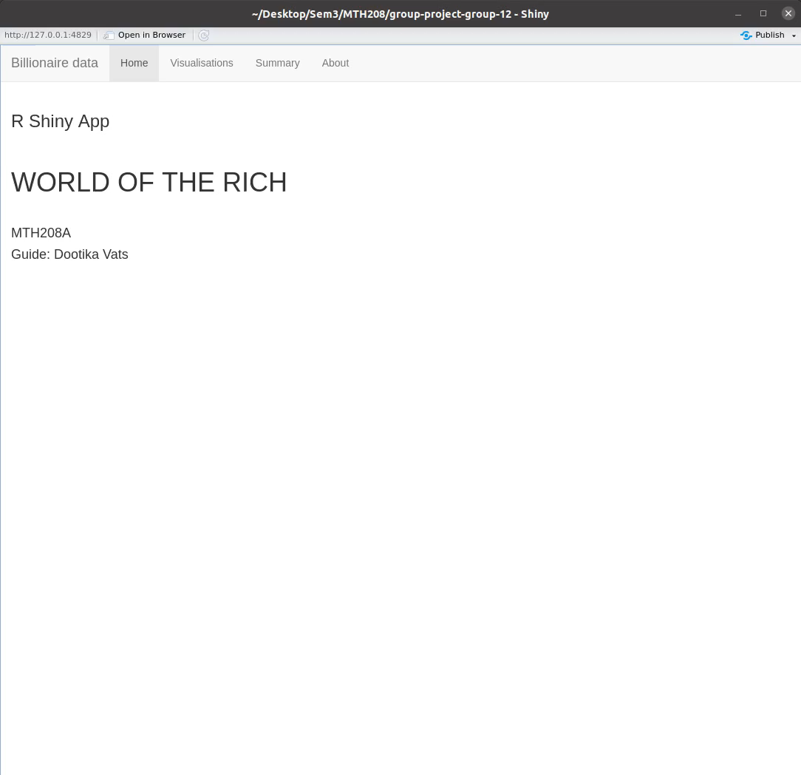

Slide 24
Conclusion:
Finance and Retail were the wealthiest industries until Technology overtook them in the recent years.
China has high Number of billionaires but average Net worth is low.
In some of the European countries, there are less number of billionaires but they own more than average.
Africa turns out to have least number of billionaires.
Generally, top 10 Billionaire’s net worth has grown in the past 10 years.
Some like Elon Musk and Jeff Bezos jumped to the top positions in recent time.
The net worth decreases exponentially as we go to the higher rank.
The top 20-25 ranks have much more net worth than the rest.
This plot clearly indicates 1.5 to 2 times increase in the wealth of top 10 Billionaires.
The ages of the top 500 billionaires has roughly remain the same for last 10 years.
Most of them belong to 40-80 age group.
There is no significant relation between Number of Billionaires and Population.
There is a positive relation between Number of Billionaires and GDP.
There seems to be no relation between Billionaires last change YTD and GDPGR.

Slide 25


This Presentation is Prepared by
Group 12

Slide 26


References:
Sources of Data:
Areppim
https://stats.areppim.com/stats/links_billionairexlists.htm
Wikipedia
https://www.wikipedia.org/
World Bank
https://data.worldbank.org/indicator/NY.GDP.MKTP.KD.ZG
https://data.worldbank.org/indicator/NY.GDP.MKTP.CD
Took Help from:
https://r-graph-gallery.com/
https://stackoverflow.com/
https://shiny.rstudio.com/gallery/
*PowerPoint is a registered trademark of Microsoft Corporation in the United States and/or other countries. We are not affiliated, connected or associated with Microsoft Corporation or Google Inc.

